Slide 1
Digitization and Automation Of Department
To
Department Of Computer Science & Engineering, Govt. COE Aurangabad
Submitted By:-
Mr. Vikas R. Desale(BE14S05F005)
Mr.Shailendra Kirtikar(BE14S05F008)
Mr. Faizan Shaikh(BE14S05F012)
Guided By:
Prof. S.G. Shikalpure
2016-17

Slide 2
Outlines
Literature Survey
Existing System
Proposed System
Design Methodology
Project Plan
References

Slide 3
Literature Survey
History of Automation.
1. Started in 1960
2. Used by Pico Electronics in 1975.
Developed X10 Power Line carrier technology which
encode and decode 120 khz electrical signal on power line.
1. Internet : Internet of Things, Wifi Technolgy., Everything connected to each other. (Speed – 3.5 Mbps, Range – 32 meters).
2. Bluetooth: Operating frequency – 2400G, Range – up to 100 meters, Speed – up to 3Mbps, Connect up to 7 devices.
3. GSM : SMS, Can be used without internet.

Slide 4
Literature Survey
Web Server : Every device is connected to web server, and all data is uploaded on it. Eg, Python based web server.
Raspberry Pi: Credit card size computer, Can be used as web server, monitoring device, sensor interfacing and driving actuators.
Arduino: Microcontroller, Can be used as a secondary device along with raspberry pi for sensor interfacing and actuator.
Sensors: Gas and Smoke Sensors, Motion Sensor,Temperature and Humidity Sensor.
Actuators: Relays.

Slide 5
Existing System
In Existing there is lots of problems
1.Department is not automated
2.Department have not there won server for secure data transfer over internet
3.In colleges the big water wastage.
4.Department does not have up-to-date information about staff and other things.

Slide 6
Proposed System
Proposed System is what it is all automated and online which is Smart Department Includes Following:-
1.Smart Low Cost Irrigation which checks moisture level and leads to help in saving water.
(Ref. In IEEE Sponsored 2nd International Conference ICEC 2015.)
2.Android Based smart home system controlled via Bluetooth or Internet Connectivity.
(Ref. 18th IEEE International Symposium.)
3.Web site which is for file sharing gives more security with encryption.
(Ref. Security Using Colors and Armstrong Numbers National Conference IEEE year 2011 )

Slide 7
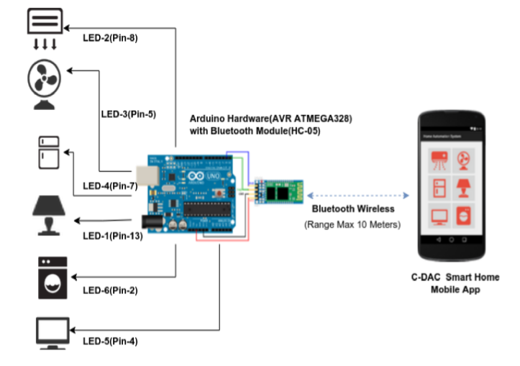
Proposed System
Automated Department

Slide 8
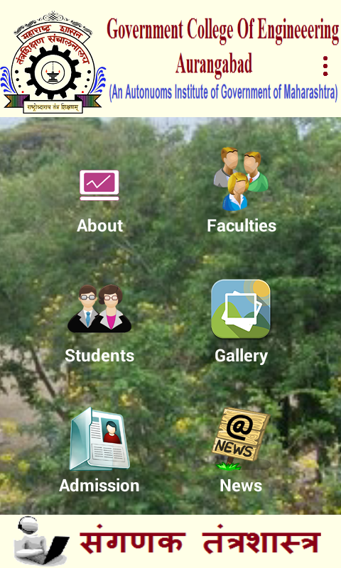
Proposed System
Digitization Department

Slide 9
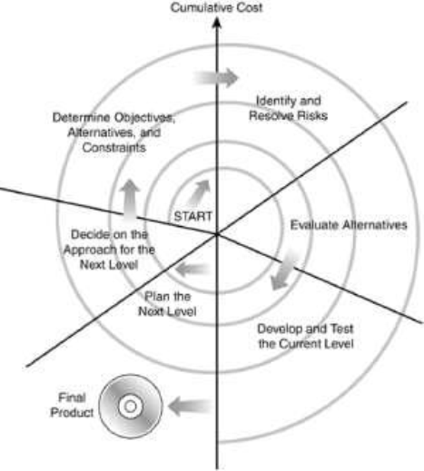
Design Methodology
1.LIFE CYCLE MODEL
Spiral Model:-
The main advantage of the Spiral Model is it gives the core model at every round. In this model I am also implements risk analysis phase.

Slide 10
Design Methodology
Software Required:-
1.Android Studio
2.Arduino Editor
3.Web Browser
Hardware Required:-
1.Android Phone
2.Arduino Kit
3.Camera
4.Sensors
5.Raspberry Pi
6.Computer System:
Dual Core processor
512 MB RAM
40 GB hard disk
Modem

Slide 11
Design Methodology
PROGRAMMING LANGUAGE REQUIRE TO IMPLEMENT SYSTEM
For Android App:-Java,XML.
For Web Server:-HTML,CSS,PHP.
For Hardware:-Arduino.
These languages help us for making application user friendly and also graphically and visually effective for the user.
The XML used for user making screen or user interface on android phone and it also link his component to java code by using reference in java code.
HTML, CSS, PHP for user interface and backend on web Server.

Slide 12
Design Methodology
Platforms
We are implementing the android application which is executed on android phone.
To execute this system I need much software and the platform used for developing this application windows os like windows up, windows 10 etc.
We are using “Windows 10” and “Android 6.0”as a platform for this system.

Slide 13
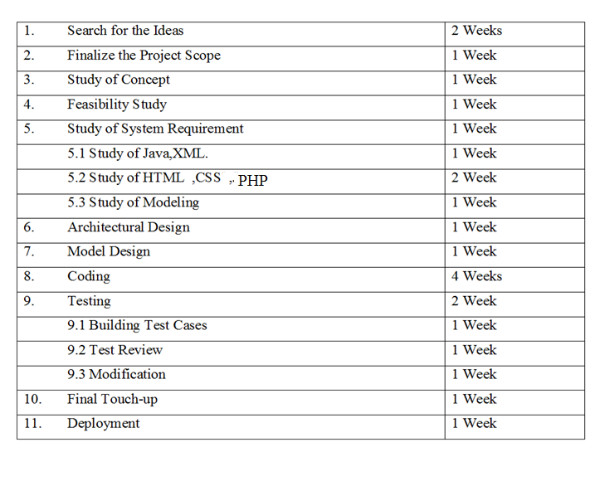
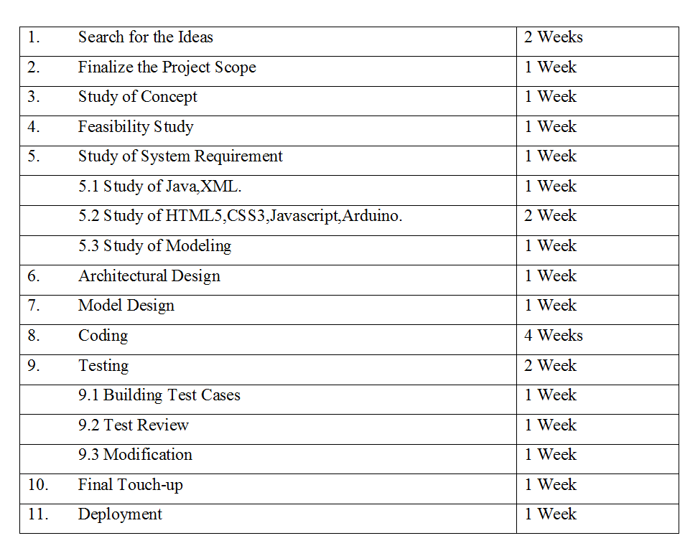
Project Plan

Slide 14
System Modules
1. Bluetooth based automation
2. Smart Irrigation
3. CompSA Android Application
4. Attendance system using Image Recognition
5. System Monitor Application

Slide 15
References
Chandankumar Sahu, Pramitee Behera, “A Low Cost Smart Irrigation Control System”, IEEE Sponsored 2nd International Conference on Electronics and Communication System (ICECS 2015)
R. Piyare and M. Tazil, "Bluetooth based home automation system using cell phone", IEEE 15th International Symposium on Consumer Electronics, pp. 192-195, 2011.
Security Using Colors and Armstrong Numbers National Conference IEEE year 2011

Slide 16
Conclusion
Thus we implemented the required applications for digitization and automation of computer science and engineering department.

